Slide 1
Programming II
(C Programming Language)
Arrays in C
(Part I)
Lecture 11, Monday March 01, 2021
Dr. Ayman ALJARBOUH

Slide 2
Outline
C Arrays, Declaring Arrays
Access Array Elements
Initializing Arrays
Change Value of Array Elements
Input and Output Array Elements

Slide 3
C Arrays
C programming language provides a data structure called Array
An array is used to store a collection of data
It is often more useful to think of an array as a collection of variables of the same type
Instead of declaring individual variables, such as number0, number1, ..., and number10, you declare one array variable such as numbers and use numbers[0], numbers[1], and ..., numbers[10] to represent individual variables

Slide 4
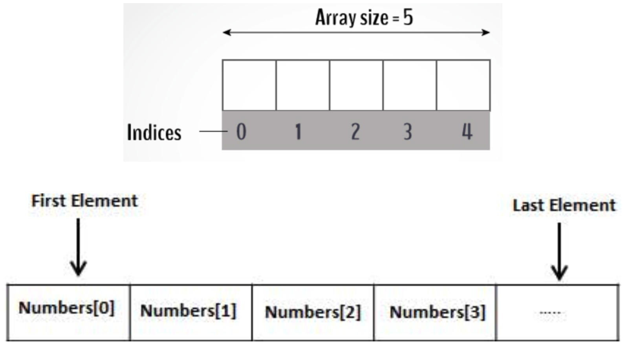
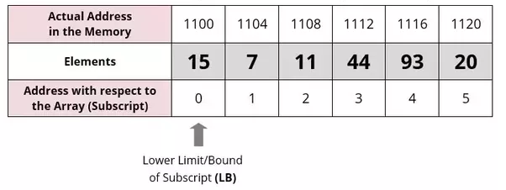
C Arrays
A specific element in an array is accessed by an index
All arrays consist of contiguous memory locations. The lowest address corresponds to the first element and the highest address to the last element

Slide 5


Declaring Arrays
To declare an array in C, you need to specify the type of the elements and the number of elements required by an array. The syntax is:
The type can be any valid C data type
The arraySize must be an integer constant greater than zero
For example, to declare a 10-element array called balance of type double, use this statement:
Here, we declared an array, balance, of double type, and it is sufficient to hold up-to 10 double numbers

Slide 6
Declaring Arrays
To declare an array in C, you need to specify the type of the elements and the number of elements required by an array. The syntax is:
The type can be any valid C data type
The arraySize must be an integer constant greater than zero
For example, to declare a 10-element array called balance of type double, use this statement:
It's important to note that the size and type of an array cannot be changed once it is declared

Slide 7
Outline
C Arrays, Declaring Arrays
Access Array Elements
Initializing Arrays
Change Value of Array Elements
Input and Output Array Elements

Slide 8
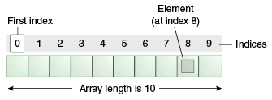
Access Array Elements
Array elements can be accessed by using indices
This is done by placing the index of the element within square brackets after the name of the array
Arrays have 0 as the first index, not 1. For example, numbers[0] is the first element of the array numbers
If the size of an array is n, to access the last element, the n-1 index is used

Slide 9
Outline
C Arrays, Declaring Arrays
Access Array Elements
Initializing Arrays
Change Value of Array Elements
Input and Output Array Elements

Slide 10
Initializing Arrays
It is possible to initialize an array during its declaration
For example
You can also initialize an array as following
Here, we haven't specified the size. However, the compiler knows its size is 5 as we are initializing it with 5 elements
The number of values between braces { } can not be larger than the number of elements that we declare for the array between square brackets [ ]

Slide 11

Initializing Arrays
It is also possible to initialize a specific array element
Following is an example to initialize a single element of the array
Array with 4th index will be 5th element number
In the above statement, we assign the 5th element in the array a value of 50.0

Slide 12
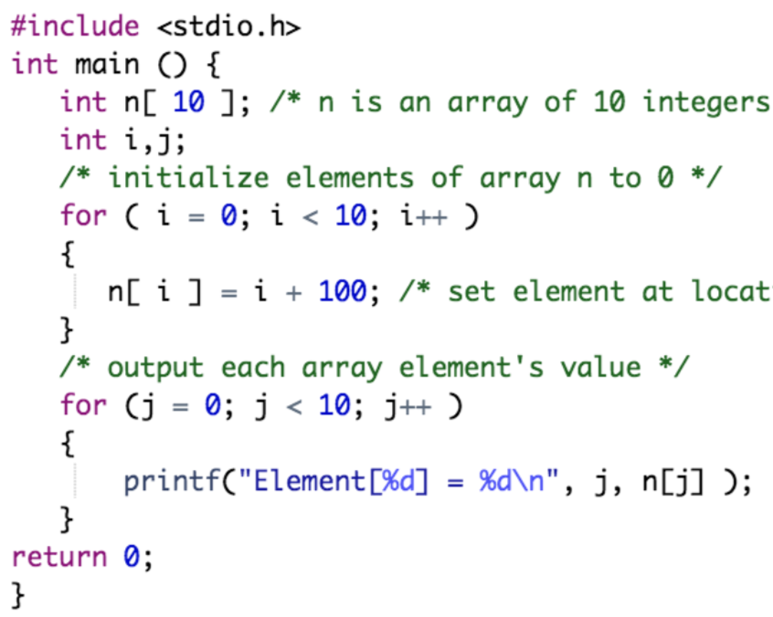
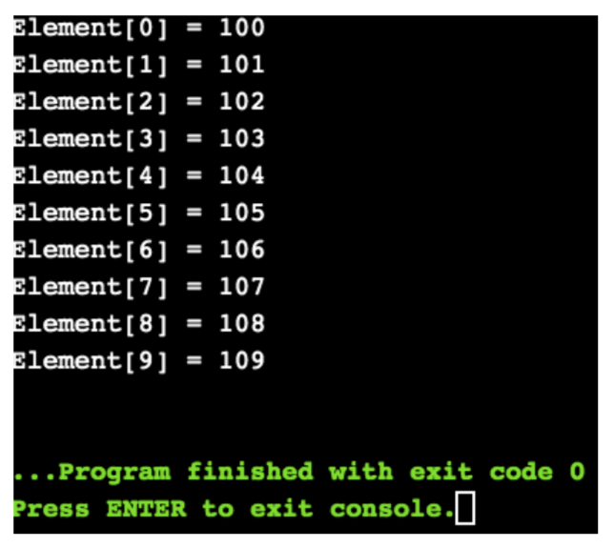
Initializing Arrays
Example:

Slide 13
Outline
C Arrays, Declaring Arrays
Access Array Elements
Initializing Arrays
Change Value of Array Elements
Input and Output Array Elements

Slide 14
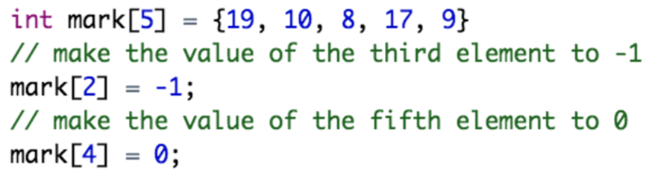
Change Value of Array Elements
It is possible to change the values of the array elements in the program
Following is an example:
In the above code, we changed the values of the 3rd and the 5th elements of the array mark

Slide 15
Outline
C Arrays, Declaring Arrays
Access Array Elements
Initializing Arrays
Change Value of Array Elements
Input and Output Array Elements

Slide 16
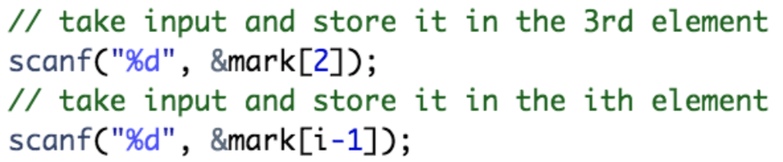
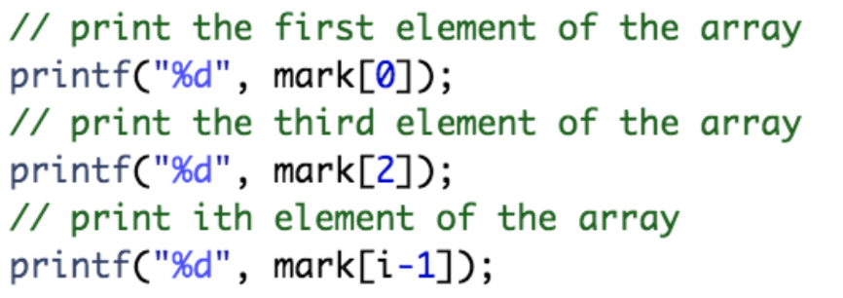
Input and Output Array Elements
Also it is possible to take input from the user and store it in an array element
Following is an example to input array elements
Following is an example to print array elements

Slide 17
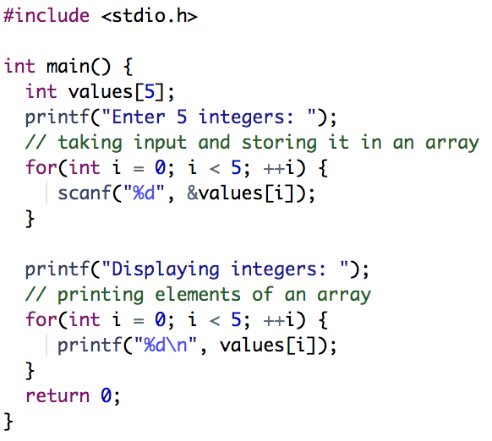
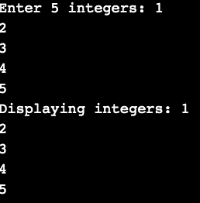
Input and Output Array Elements
Example:

Slide 18
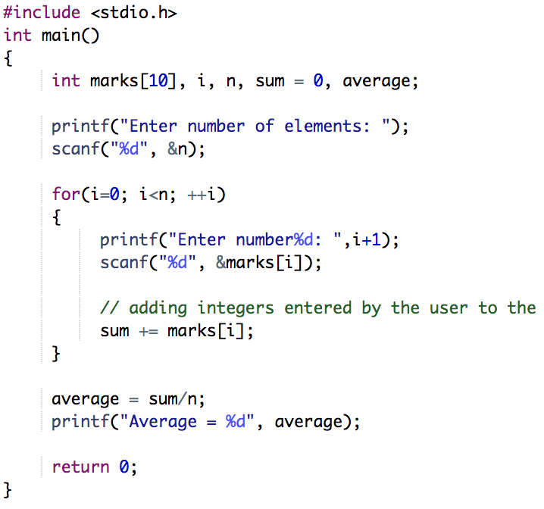
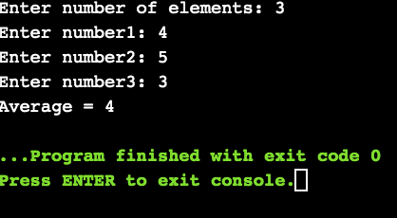
Input and Output Array Elements
Example:

Slide 19

Access an Array Out of Its Bound
Suppose you declared an array of 10 elements. Let's say,
You can access the array elements from balance[0] to balance[9]
Now let's say if you try to access balance[12]. The element is not available. This may cause unexpected output (undefined behavior)
Sometimes you might get an error and some other time your program may run correctly
Hence, you should never access elements of an array outside of its bound

Slide 20
Practical Exercises
Write and Compile the following C programs:
Program 1:

Slide 21
Practical Exercises
Write and Compile the following C programs:
Program 2:

Slide 22
Practical Exercises
Write and Compile the following C programs:
Program 3:

Slide 23
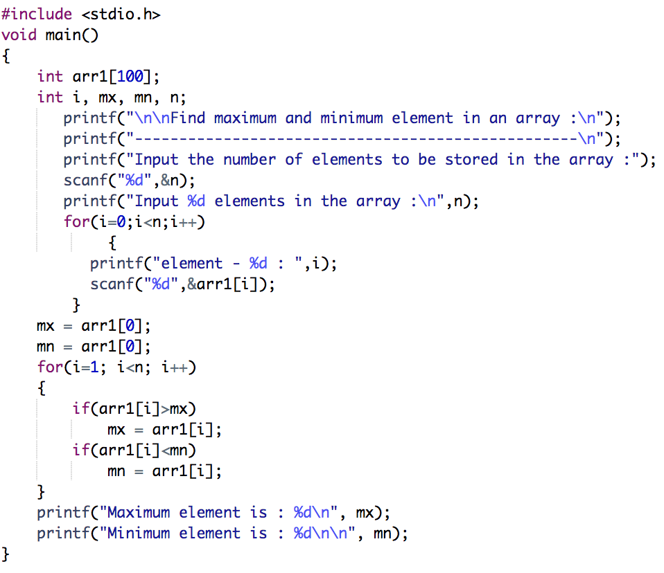
Practical Exercises
Write and Compile the following C programs:
Program 4:

